Slide 1





AtomScape

Slide 2
Contents
01
02
03
04
Our Team
Our Goal
Stages of realization
Used Technologies

Slide 3
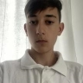
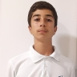
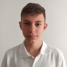
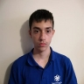
Our Team
Teodor Madjarov
Scrum Trainer
Apostol Kupenov
Back-end Developer
Ivan Tsvyatkov
Front-end Developer
Lubo Dimov
Back-end Developer

Slide 4

Our Goal
Our mission at AtomScape is to provide players with an immersive and dynamic gaming experience. We aim to create a challenging yet enjoyable environment.

Slide 5
Stages of realization
1.Organization
2.Decide the idea
Development
4.Presentation

Slide 6








Used Technologies

Slide 7

Let’s move into the game.

